Slide 1
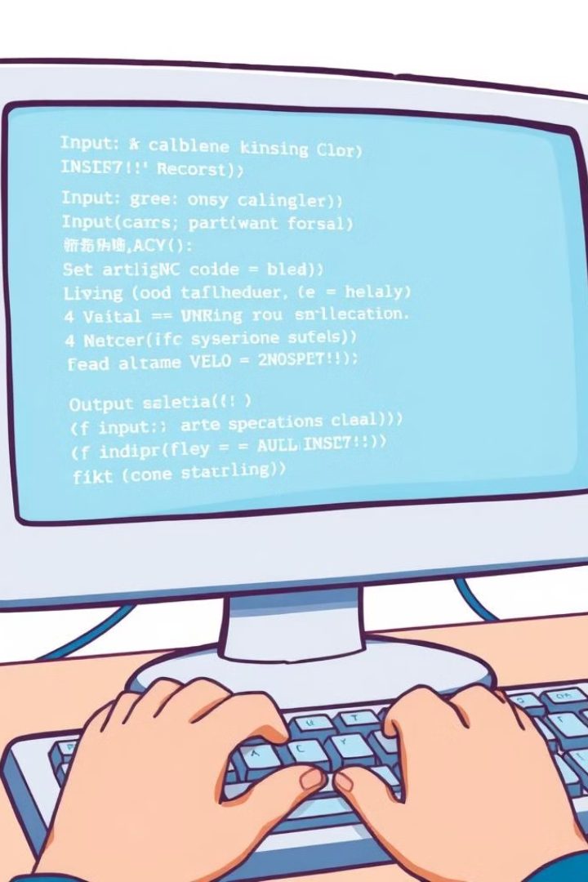

Input and Output Operations in C
This chapter shows you how to use C's input and output functions. We'll cover the basic functions like `printf()`, `scanf()`, `getchar()`, and `putchar()`. We'll also talk about data types and give you some examples.
by Istiak Rahman

Slide 2
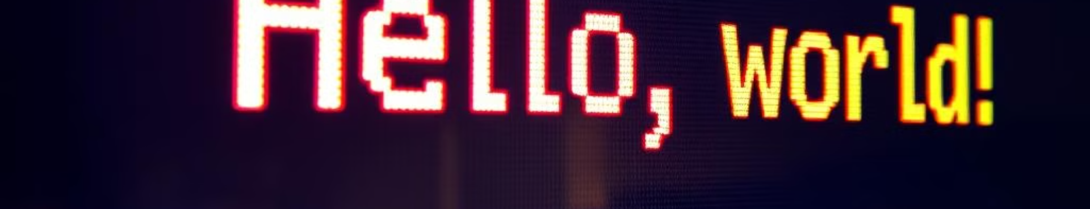
The printf() Function
Outputting Text
Formatting Specifiers
Example
The `printf()` function is used to display text on the screen. It takes a format string as its first argument, which includes the text you want to display.
The `printf()` function utilizes format specifiers to determine how to display the values of variables. These specifiers act as placeholders, indicating the type of data to be printed.
For example, `printf("Hello, World!\n");` will print "Hello, World!" on the screen followed by a newline character. The `\n` character moves the cursor to the next line.

Slide 3
The scanf() Function
Input from the User
Storing Input
Example
The `scanf()` function is used to receive input from the user. It reads data from the standard input, which is usually the keyboard.
The `scanf()` function takes a format string as its first argument, similar to `printf()`, to specify the type of data it should expect. It then stores the input data in the variables provided as subsequent arguments.
For example, `scanf("%d", &age);` reads an integer value from the user and stores it in the `age` variable. The `&` symbol is used to provide the address of the variable, allowing `scanf()` to modify the value.

Slide 4
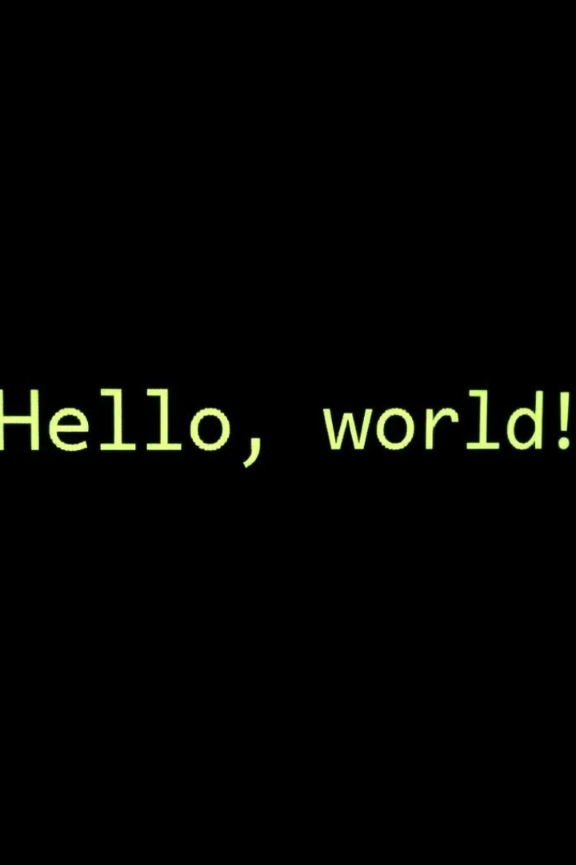

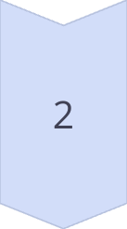

Character Input and Output
getchar()
The `getchar()` function reads a single character from the input stream. It returns the character as an integer value, which can be stored in a `char` variable.
putchar()
The `putchar()` function writes a single character to the output stream. It takes a character as its argument and displays it on the screen.
Example
Combining `getchar()` and `putchar()` allows you to read a character from the user and then display it back on the screen.

Slide 5
Data Types in C
Data Type
Format Specifier
Description
int
%d
Used for storing whole numbers, including positive, negative, and zero.
float
%f
Used for storing single-precision decimal numbers with a limited range and precision.
double
%lf
Used for storing double-precision decimal numbers, offering a wider range and higher precision compared to `float`.
char
%c
Used for storing single characters, such as letters, numbers, and punctuation marks.
unsigned int
%u
Used for storing non-negative whole numbers, specifically for situations where you need to represent only positive values.
string
%s
Used for storing a sequence of characters, commonly known as a text string. In C, strings are represented as arrays of characters.

Slide 6
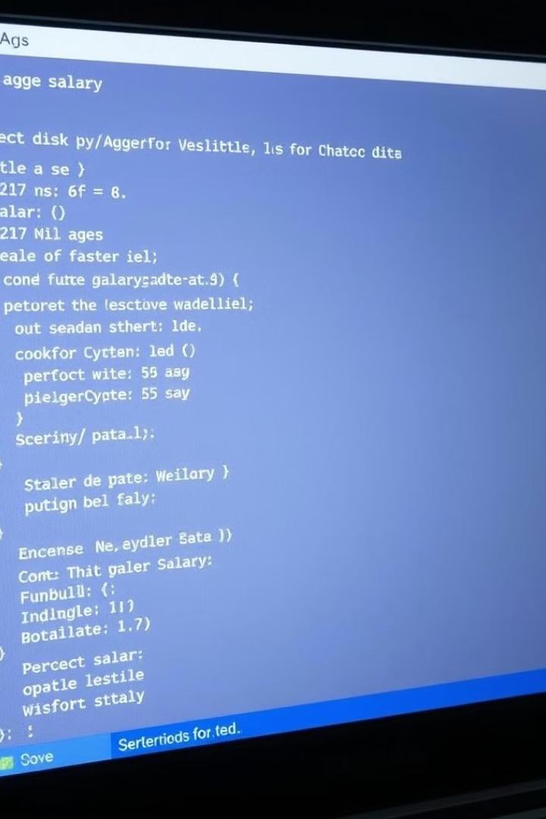
Example 1: Basic Input and Output
1
Input
The program first prompts the user to enter their age and salary.
2
Data Storage
The input is stored in variables of the appropriate data types: `age` as an integer and `salary` as a float.
3
Output
The program then displays the user's age and salary back on the screen, using `printf()` to format the output.
4
Return Value
The program returns 0, indicating successful execution.

Slide 7
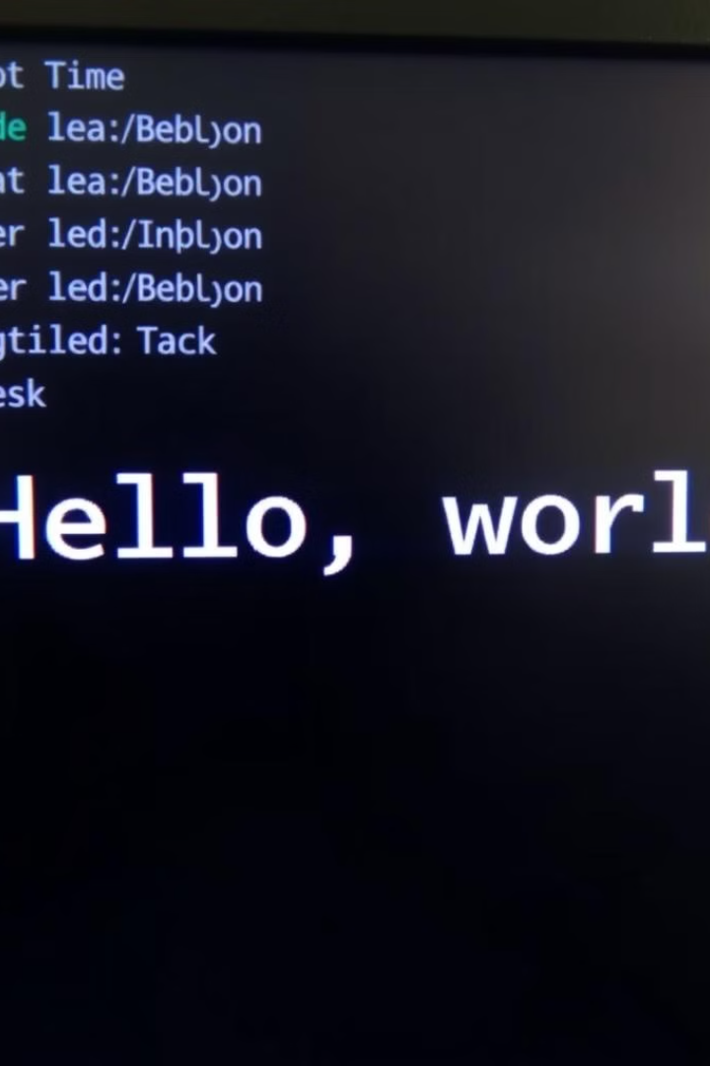
Example 2: Using getchar() and putchar()
1
Input
The program prompts the user to enter a character. The `getchar()` function then reads the character from the input stream.
2
Output
The program then displays the character on the screen using the `putchar()` function.
3
Return Value
The program returns 0, indicating successful execution.

Slide 8
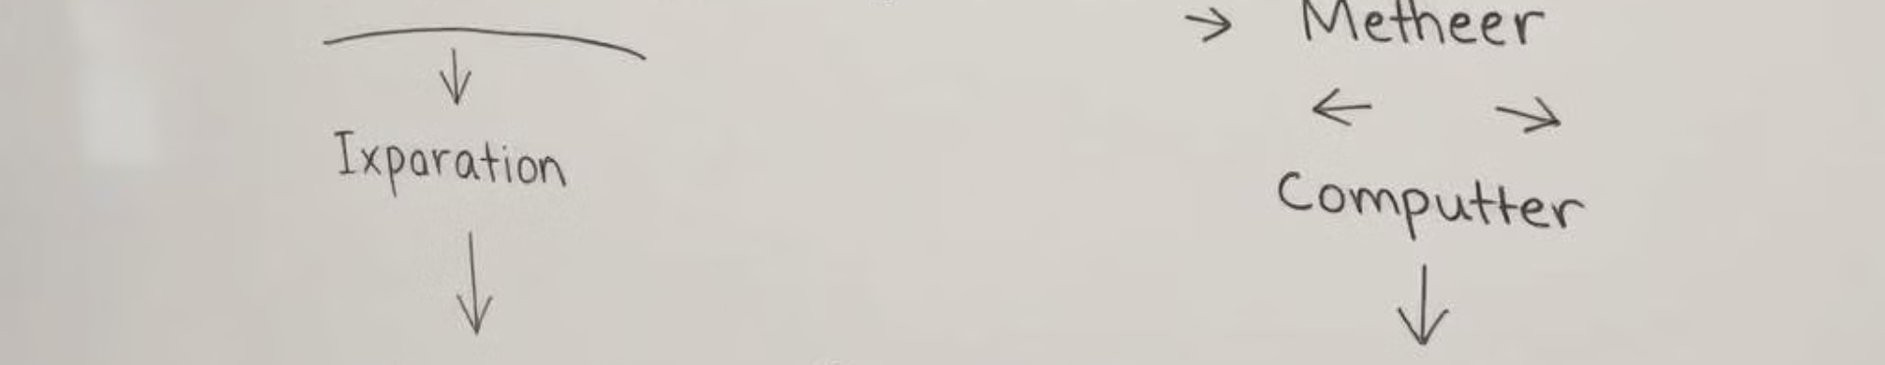



Key Concepts
Input Formats
Output Formats
Basic User Interaction
The `scanf()` function allows you to control the data format expected from the user, ensuring that the program receives the correct input.
The `printf()` function allows you to control how data is displayed on the screen, providing a clear and organized presentation to the user.
The `scanf()` and `printf()` functions provide the fundamental tools for creating interactive programs that communicate effectively with the user.

Slide 9

Thank You!
Presented by: Istiak Rahman
Email: istiak.rahman1020@gmail.com
Thank you for your attention! I appreciate your time and interest.
Keep Learning, Keep Growing

